Slide 1
SHAN
Shift Handover Application for Nurses

Slide 2
Patole Kunal Kishor
120IT1214A
Pawar Herschel Pravin
120IT1108A
Raj Aditya Krishna
120IT1085A
Rathod Chandan Sudhir
121IT3085A

Slide 3
Content
Introduction
Literature survey
Motivation & Objective
System architecture
Proposed work with methodology
Software and hardware requirements

Slide 4
Introduction
Nurses have a difficult task in treating patients. They frequently supervise 30 or more patients. They must remember all of the medications they supplied to the patients, as well as all of the processes they performed, such as changing saline, measuring blood pressure and temperature, and several other jobs, in addition to always recording them so they do not give out incorrect information.
There is a need to digitize this procedure and employ new technologies to reduce their workload. The project intends to do the same thing.

Slide 5
Literature survey
TITLE | “Progressive Web Apps: A Novel Way for Cross-Platform Development”, Saint Louis University, September 2020.
AUTHOR | Patrick Mole
AIM OF THE PAPER | The development of mobile web applications has matured as a result of recent advances in web technology. By reading this paper we decided the technologies which would be used to create the Web-App

Slide 6
Literature survey
TITLE | “User Interface Design”, University of Texas, January 2006.
AUTHOR | Andrew Dillon
AIM OF THE PAPER | Software developers face the challenging task of creating user-friendly, simple-to-learn computer interfaces. By reading this paper we got to know the importance of UI design and we created the UI by its guidelines

Slide 7
Literature survey
TITLE | Design Patterns and Extensibility of REST API for Networking Applications
AUTHOR | L. Li, W. Chou, W. Zhou and M. Luo
AIM OF THE PAPER | We understood REST API design pattern and it’s implementation

Slide 8
Literature survey
TITLE | “Impact of Structured Clinical Handover Protocol on Communication and Patient Satisfaction”, Journal of Patient Experience.
AUTHOR | Ghosh, Sayani & Ramamoorthy, Lakshmi & Biju Pottakkat (2021).
AIM OF THE PAPER | In order to maintain continuity in patient care, the handover procedure is a crucial component of clinical practice on a daily basis By reading this paper we got to know the importance of communication for nurses during critical times.

Slide 9
Literature survey
TITLE | “Effectiveness of handover guideline in prevention of nursing errors”, International Journal of Applied Research.
AUTHOR | Thokchom Kiran Singh, Mosphea Khanam, Anita Sonowal
AIM OF THE PAPER | Important information gaps, omissions, errors, and patient harm can result from ineffective and inefficient handoffs By reading this paper we got to know about the general errors caused by the nurses while communicating with the doctor.

Slide 10
Motivation & Objective
Our software's objective is to save data (for example, patient details, vital signs, rhythm, and so on) and then provide it to the nurse and doctor. This not only saves time by not having to perform all of the work manually, but it also makes it easier because the data is saved with timestamps and the nurse's details. Instead of keeping notes, nurses may focus on working hard and providing excellent care to their patients. Our program reduces the amount of communication required while changing shifts.

Slide 11
System Architecture / parts
Superadmin
Administrators are added by the Superadmin
Admin
Administrators add nurses
Nurse
Enter patient information
Access patient details
Edit patient details

Slide 12
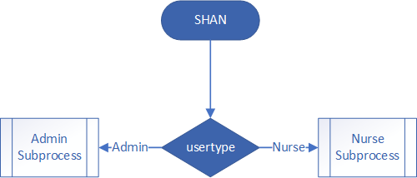
System Architecture

Slide 13
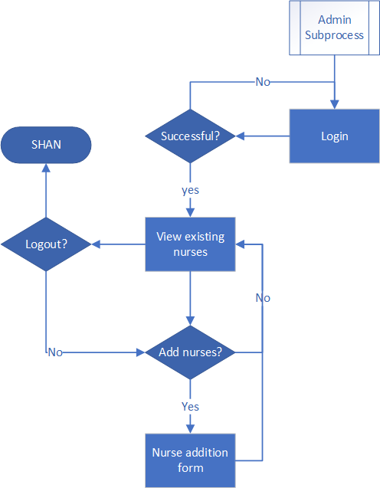
System Architecture

Slide 14
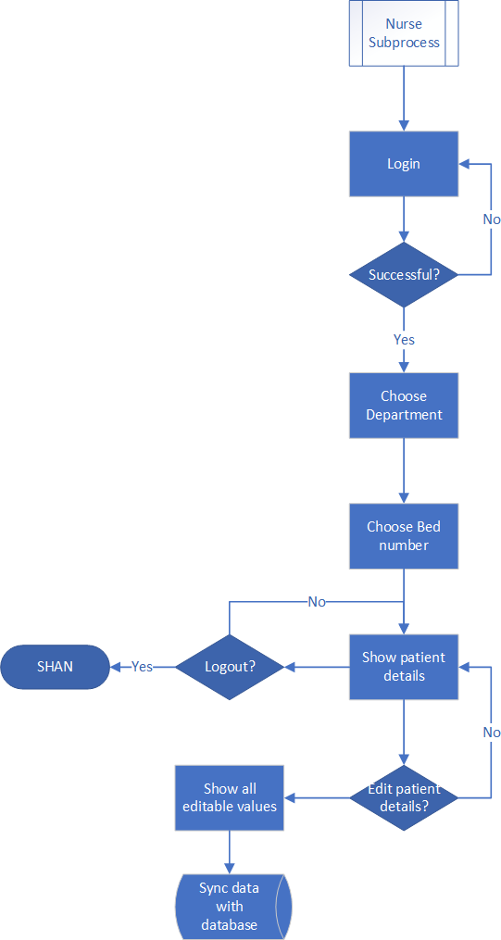
System Architecture

Slide 15
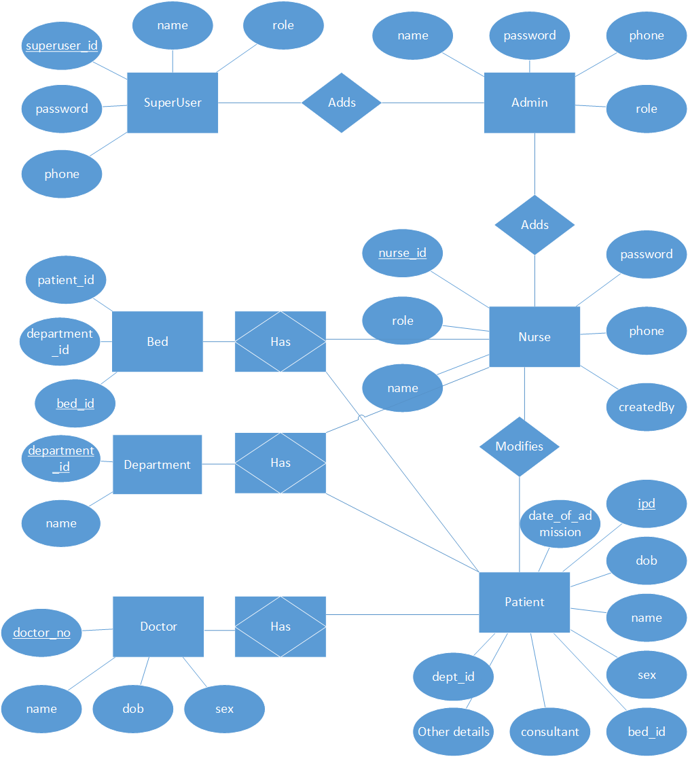
System Architecture / ER DIAGRAM

Slide 16
Proposed work with methodology
Ease of use
Responsive
Cost effective
Fantastic graphics

Slide 17
Software and hardware requirements
Hardware Requirement:
CPU
Intel Xeon E3-1245 v2 (4c/8t, 3.40GHz)
RAM
8GB
Storage
At least 30GB
Networking
At least 100mbps up and down
Software requirement:
OS
Linux or Windows
Node.JS and NPM
The whole software stack
Version control
Git

